Slide 1

CRO | AMU | LP | Next Gen 360 Campaign (mobile) | /military-degrees/overview (10893)
American Military University
CRO | 2026
American Public Education Inc. Do Not Distribute.

Slide 2
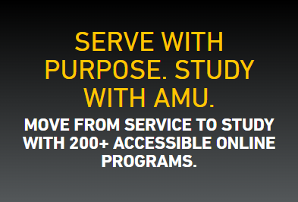



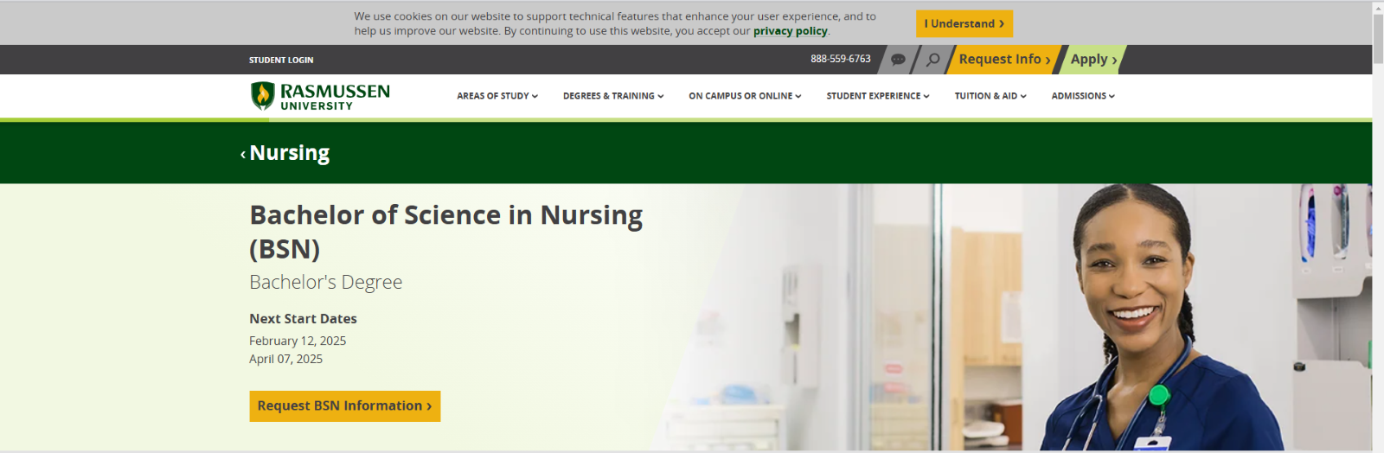
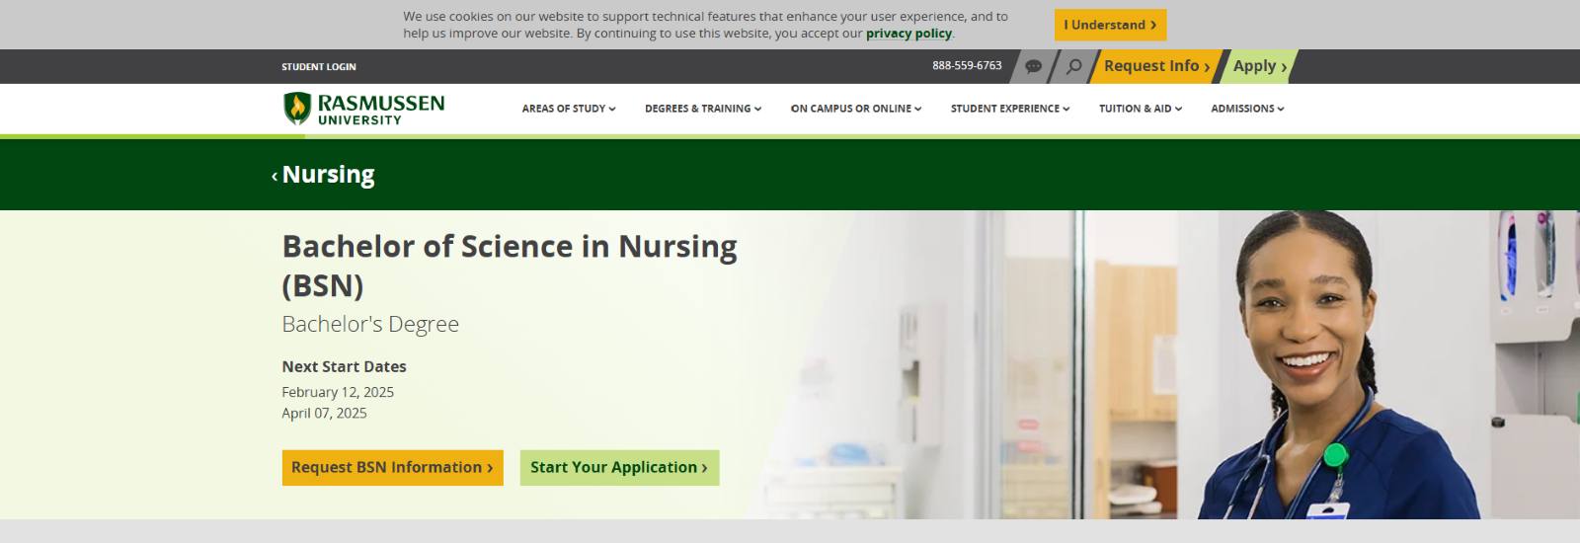
RESULTS
CRO | AMU | LP | Next Gen 360 Campaign (mobile) | /military-degrees/overview (10893)
INCONCLUSIVE
Hypothesis
If we use the Next Gen 360 mobile hero copy,
then brand RFI will match or beat the control,
because the copy keeps the same military value proposition.
PRIMARY METRIC: RFI
CONTROL
RFI: 292 Apps: 85
Brand RFI Lift (New Copy): | +8.73%
Brand App Lift (New Copy): | -18.44%
Statistical Significance: | RFI 86% brand, 97% all
Annualized Incremental Revenue: | $0 (shipped, not credited)
NEW COPY (SHIPPING)
New copy lifted RFI on all traffic (+10.6% at 97%) but not on the targeted brand campaigns (+8.7% at 86%). Brand App Complete fell 18.4% (89.8% confidence of a loss), flipping that segment to negative projected revenue. Keep control; retest copy later.
Duration: 14 Days
RFI: 316 (+8.73% | 86%)
Apps: 69 (-18.44% | 89.8% worse)
Rev: ($201,911)
Result:
Test Period: 09/15/2026 to 09/29/2026 (data through 09/28)
Page: start.amu.apus.edu/military-degrees/overview | Panel: targeted brand campaigns

Slide 3
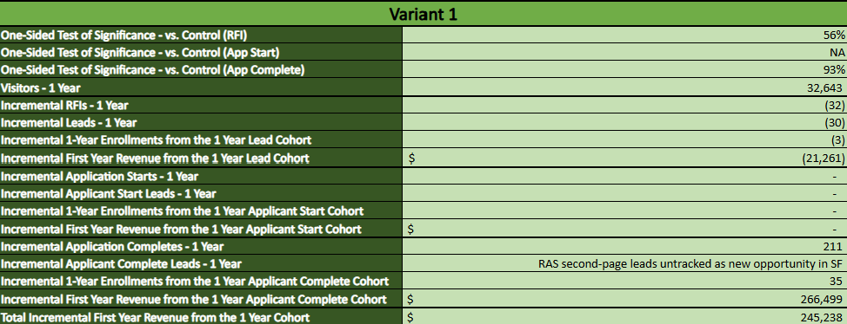
REVENUE CALCULATOR
 | V0: Control (Brand Specific Campaigns) | V1: New Copy (Brand Specific Campaigns) | V0: Control (All Campaigns) | V2: New Copy (All Campaigns)
RFI Conversions | 292 | 316 | 669 | 753
RFI Lift % | Baseline | +8.73% | Baseline | +10.63%
Statistical Significance, RFI | Baseline | 85.8% | Baseline | 97.4%
App Completes | 85 | 69 | 164 | 159
App Lift % | Baseline | -18.44% | Baseline | -4.71%
Statistical Significance, App | Baseline | 89.8% (worse) | Baseline | 66.8% (worse)
Projected Revenue, RFI path only | Baseline | $231,113 | Baseline | $652,269
Annualized Revenue Lift (projected) | Baseline | ($201,911) | Baseline | $436,733
V0 = Control; V1 = New Copy (Brand Specific Campaigns); V2 = New Copy (All Campaigns)
Final GA4 data 09/15 to 09/28/2026 (14 days; paused 09/29). New Copy ships on a business decision (10/01), so projections are not credited. Only 24.7% of mobile sessions came from the two Brand Specific Campaigns; the rest was mainly FB social prospecting and Demand Gen.

Slide 4
COMBINED: CONTROL VS NEW COPY
Desktop and Mobile added together (approximation)
 | V0: Control (Brand Specific Campaigns) | V1: New Copy (Brand Specific Campaigns) | V0: Control (All Campaigns) | V2: New Copy (All Campaigns)
Sessions (Desktop + Mobile) | 5,555 | 5,503 | 19,902 | 20,234
RFI Conversions | 383 | 399 | 886 | 983
RFI CVR % | 6.89% | 7.25% | 4.45% | 4.86%
RFI Lift % | Baseline | +5.16% | Baseline | +9.13%
Statistical Significance, RFI | Baseline | 76.7% | Baseline | 97.3%
App Completes | 137 | 134 | 300 | 307
App CVR % | 2.47% | 2.44% | 1.51% | 1.52%
App Lift % | Baseline | -1.27% | Baseline | +0.65%
Statistical Significance, App | Baseline | 54.2% (worse) | Baseline | 53.2%
Projected Revenue, RFI path only | Baseline | $222,128 | Baseline | $858,918
Annualized Revenue Lift (projected) | Baseline | $162,802 | Baseline | $922,404
Desktop + Mobile Projections Added | Baseline | $450,752 | Baseline | $1,135,923
V0 = Control; V1 = New Copy (Brand Specific Campaigns); V2 = New Copy (All Campaigns)
Approximation: desktop (09/14 to 09/28, 15 days) and mobile (09/15 to 09/28, 14 days) ran as separate tests, so their counts are added together. Desktop New Copy is the New_Copy_v2 arm. Lift, significance and the first two revenue rows use the added counts. The last row adds each device's own projection instead; it is higher because mobile holds more of the added sessions than its share of real traffic. Projections only, not credited.

